Slide 1
OOPs Concepts in Java

Slide 2
Version Control and Revision History
 | Name | Date
Prepared By | Paranthaman | 09-07-2019
Reviewed By | Team | 09-07-2019
Approved By | Team | 09-07-2019
Version No. | Date | Affected Sections | Highlights
2.0.0 |  | ALL | Updated Based on the course sheet coverage

Slide 3








Iconic Representations.......
Test your Memory
Can you Solve?
Objective
Coffee Break
Queries
Recap
Need more Info
Brainstorm

Slide 4
Objective
Type of Relationships in JAVA
Inheritance
Type of Inheritances
Constructor in Inheritance
Object Type Casting
Polymorphism
Over Loading
Overriding
Abstract Class
Abstract Method
Final
Notes:
It should be mentioned to the participant that current version of Java is 1.5, although not covered as part of this training.

Slide 5
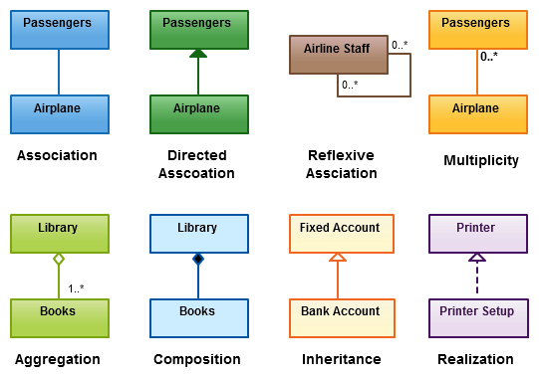
Type of Relationships in JAVA

Slide 6
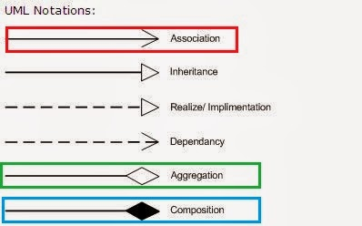
UML Notations for Relationship

Slide 7
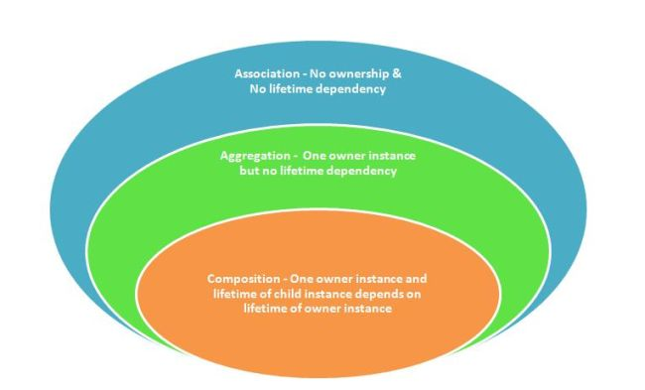
Association
Association is relation between two separate classes which establishes through their Objects. Association can be one-to-one, one-to-many, many-to-one, many-to-many.
In Object-Oriented programming, an Object communicates to other Object to use functionality and services provided by that object.
Composition and Aggregation are the two forms of association.

Slide 8
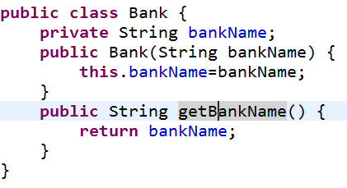
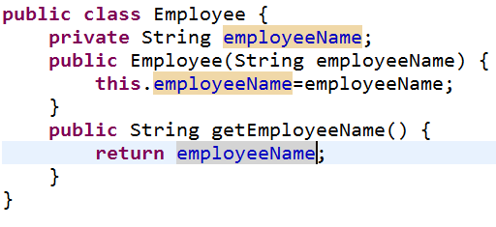
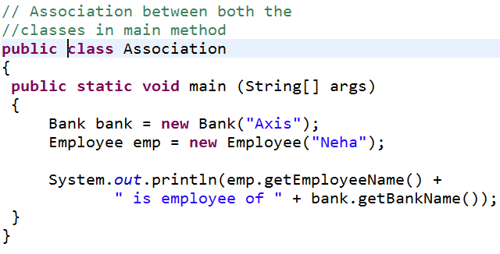
Coding For Association

Slide 9
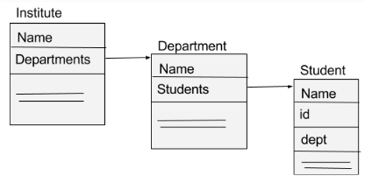
Aggregation
It is a special form of Association
It represents Has-A relationship.
It is a unidirectional association i.e. a one way relationship.
In Aggregation, both the entries can survive individually which means ending one entity will not effect the other entity

Slide 10
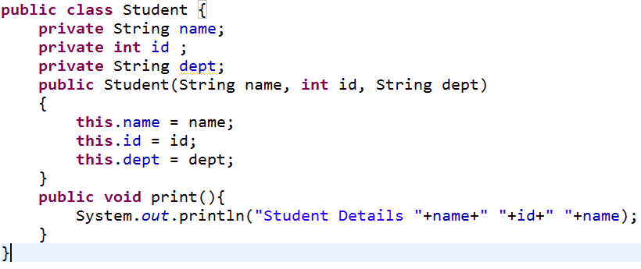
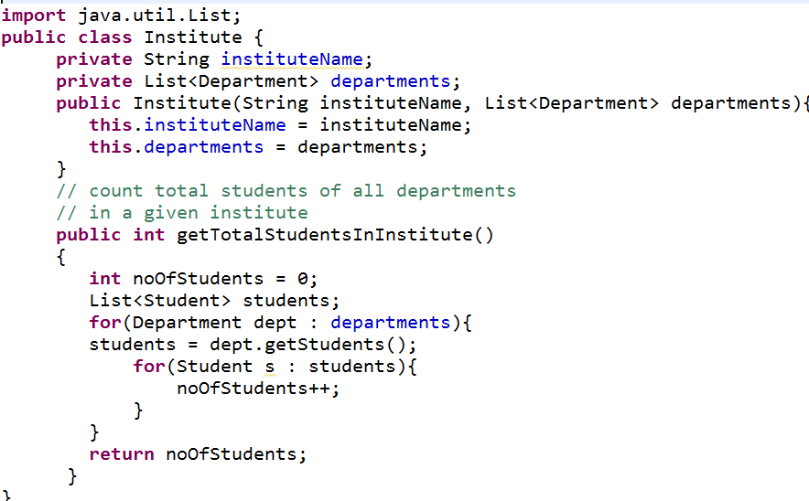
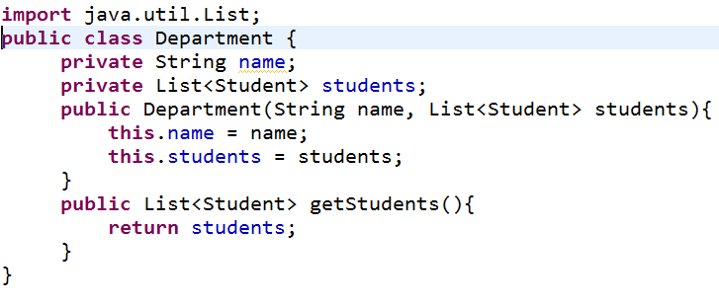
Coding For Aggregation

Slide 11
Composition
Composition is a restricted form of Aggregation in which two entities are highly dependent on each other.
It represents part-of relationship.
In composition, both the entities are dependent on each other.
When there is a composition between two entities, the composed object cannot exist without the other entity.
Aggregation vs. Composition
Dependency: Aggregation implies a relationship where the child can exist independently of the parent. For example, Bank and Employee, delete the Bank and the Employee still exist. whereas Composition implies a relationship where the child cannot exist independent of the parent. Example: Human and heart, heart don’t exist separate to a Human
Type of Relationship: Aggregation relation is “has-a” and composition is “part- of” relation.
Type of association: Composition is a strong Association whereas Aggregation is a weak Association.

Slide 12
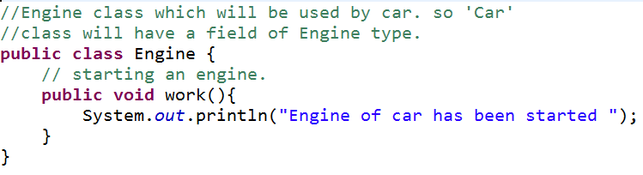
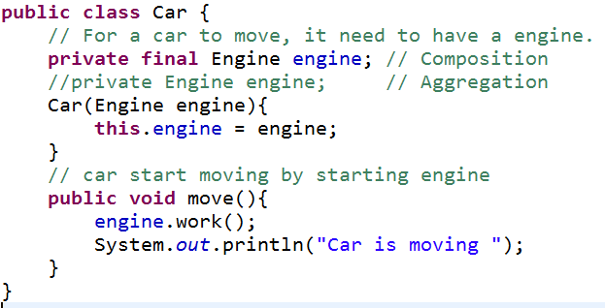
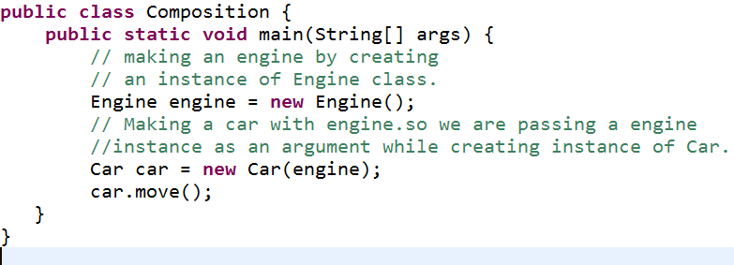
Coding For Composition

Slide 13
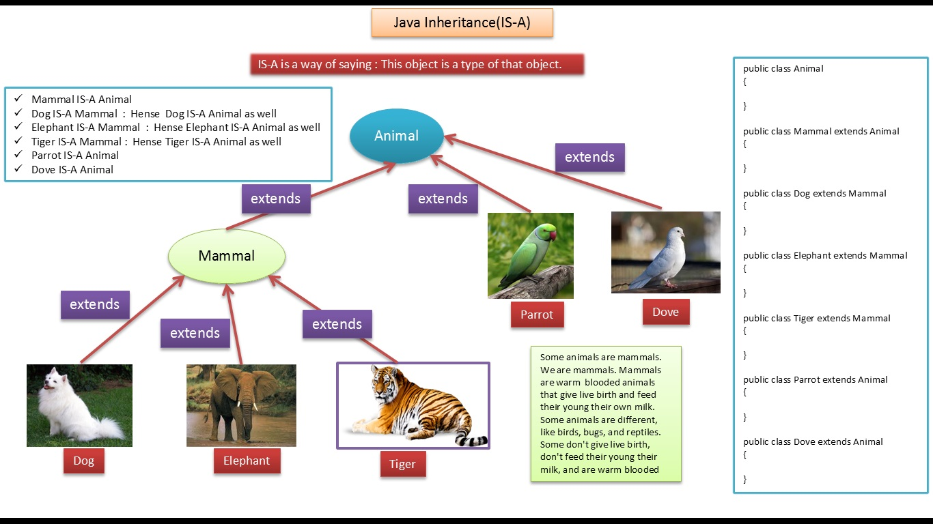
Inheritance

Slide 14
Creating Objects for Inheritance classes
Animal animal=new Animal();
Dog dog=new Dog();
Parrot parrot=new Parrot();
Instance of Animal
Instance of Animal
Instance of Mammal
Instance of Dog
Instance of Animal
Instance of Parrot

Slide 15
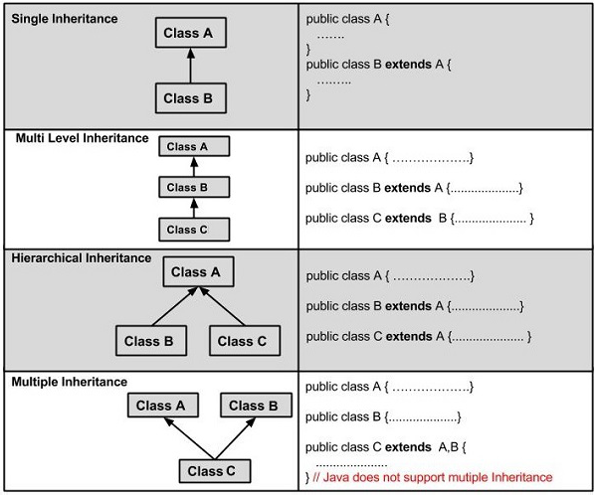
Type of Inheritances

Slide 16
Important terminology in Inheritance
Super Class: The class whose features are inherited is known as super class( base, or parent class).
Sub Class: The class that inherits the other class is known as sub class(derived, or child class). The subclass can add its own fields and methods in addition to the superclass fields and methods.
Reusability: Inheritance supports the concept of “reusability”.
Default superclass: Except Object class, which has no superclass. In the absence of any other explicit superclass, every class is implicitly a subclass of Object class.
Superclass can only be one: A superclass can have any number of subclasses. But a subclass can have only one superclass.
Inheriting Constructors: A subclass inherits all the members (fields, methods, and nested classes) from its superclass. Constructors are not members, so they are not inherited by subclasses, but the constructor of the superclass can be invoked from the subclass.
Private member inheritance: A subclass does not inherit the private members of its parent class. However, if the superclass has public or protected methods (getters and setters) for accessing its private fields.

Slide 17
What all can be done in a Subclass?
The inherited fields can be used directly, just like any other fields.
We can declare new fields in the subclass that are not in the superclass.
The inherited methods can be used directly as they are.
We can write a new instance method in the subclass that has the same signature as the one in the superclass, thus overriding it (as in example above, toString() method is overridden).
We can write a new static method in the subclass that has the same signature as the one in the superclass, thus hiding it.
We can declare new methods in the subclass that are not in the superclass.
We can write a subclass constructor that invokes the constructor of the superclass, either implicitly or by using the keyword super.

Slide 18
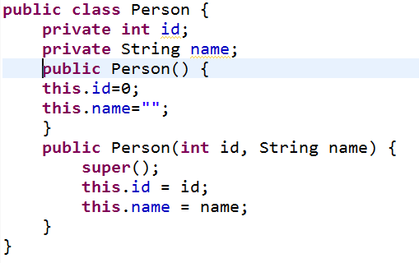
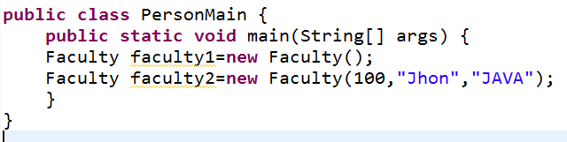
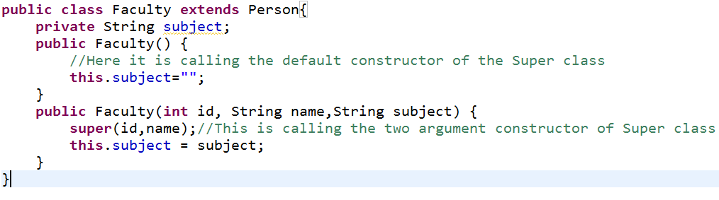
Constructor in Inheritance

Slide 19
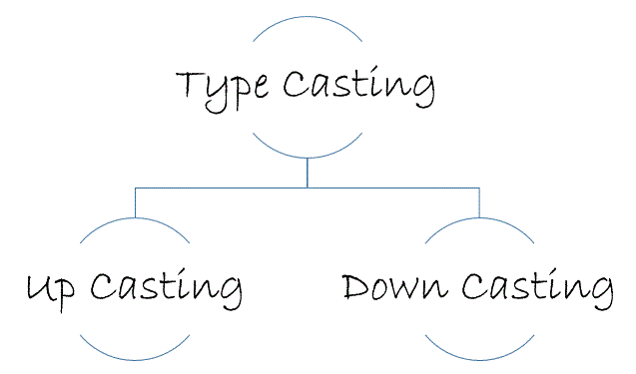


Object Type Casting
Person
Faculty
This throws ClassCastException

Slide 20
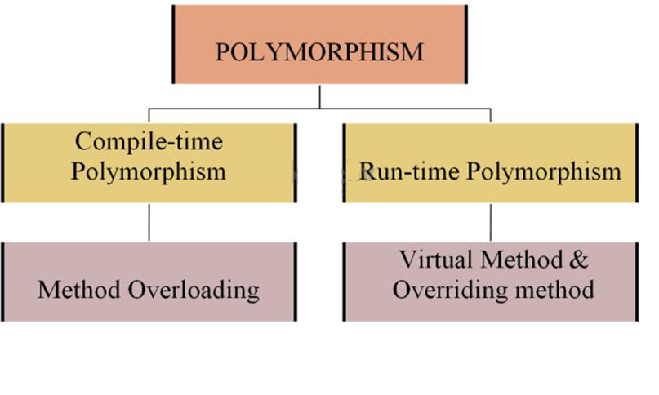
Polymorphism

Slide 21
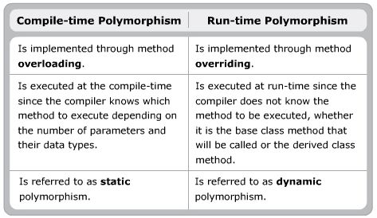
Polymorphism

Slide 22
Method Overloading
If a class has multiple methods having same name but different in parameters, it is known as Method Overloading.
If we have to perform only one operation, having same name of the methods increases the readability of the program
Advantage of method overloading
Method overloading increases the readability of the program.
Different ways to overload the method
There are two ways to overload the method in java
By changing number of arguments
By changing the data type

Slide 23
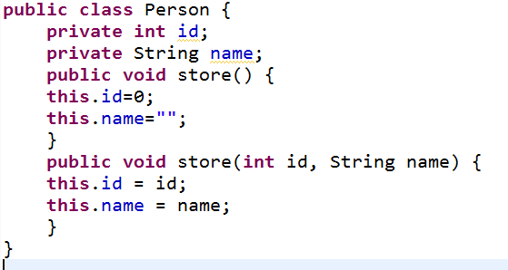
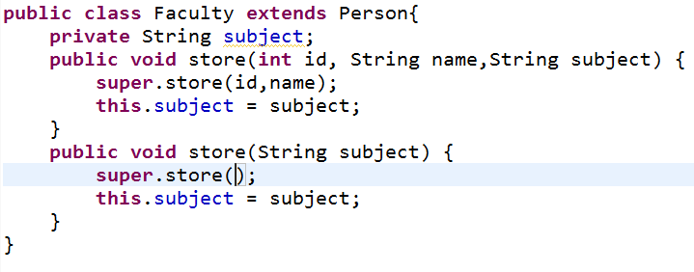
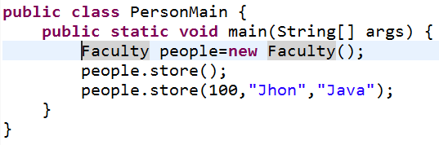
Method Overloading

Slide 24
Method Overriding
If subclass (child class) has the same method as declared in the parent class, it is known as method overriding in java.
Usage of Java Method Overriding
Method overriding is used to provide specific implementation of a method that is already provided by its super class.
Method overriding is used for runtime polymorphism
Rules for Java Method Overriding
method must have same name as in the parent class
method must have same parameter as in the parent class.
must be IS-A relationship (inheritance).
If it is a private method in the Parent class, it cannot be overridden.
Overriding method should have more access or equal access than Parent class method which is overridden.

Slide 25
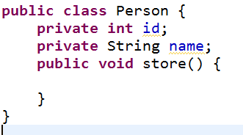
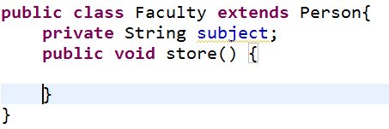
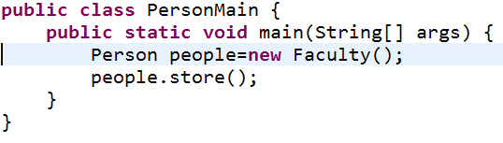
Method Overriding

Slide 26
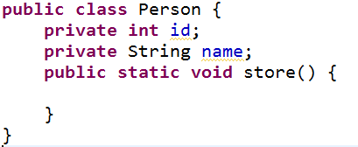
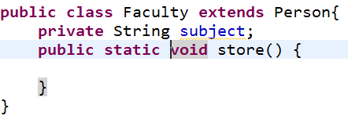
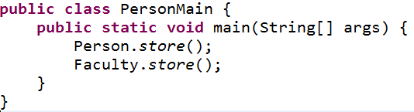
Method Hiding
If subclass (child class) has the same method as declared in the parent class, it is known as method overriding in java. Both methods must be static methods.

Slide 27
Abstract Class
There is a super class used it only by sub classes and creating instance of the class is no use. It should a abstract class.
A class that is declared with abstract keyword, is known as abstract class in java. It can have abstract and non-abstract methods (method with body).
Abstract classes may or may not contain abstract methods, i.e., methods without body ( public void get(); )
But, if a class has at least one abstract method, then the class must be declared abstract.
If a class is declared abstract, it cannot be instantiated.
To use an abstract class, you have to inherit it from another class.
If you inherit an abstract class, you have to provide implementations to all the abstract methods in it.

Slide 28
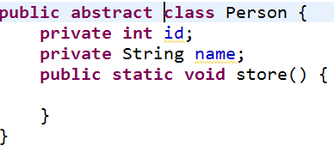
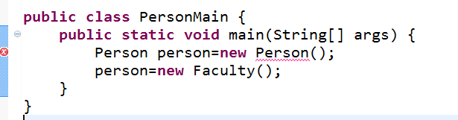
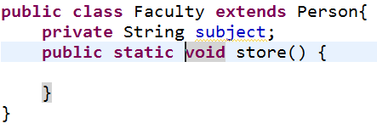
Abstract Class

Slide 29
Abstract Method
If you want a class to contain a particular method but you want the actual implementation of that method to be determined by child classes, you can declare the method in the parent class as an abstract.
abstract keyword is used to declare the method as abstract.
You have to place the abstract keyword before the method name in the method declaration.
An abstract method contains a method signature, but no method body.
Instead of curly braces, an abstract method will have a semi colon (;) at the end.

Slide 30
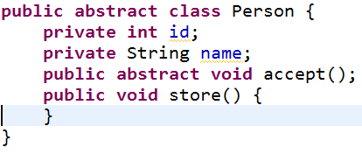
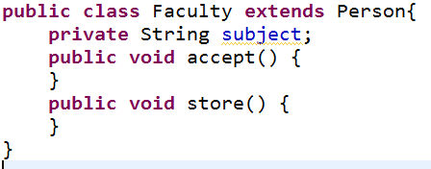
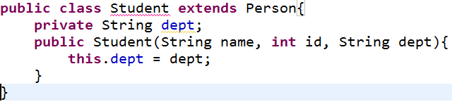
Abstract Method

Slide 31
Final
Final variables are variables that cannot be changed
we can have final method. Means method that cannot be changed. Behaviour of a method can only be changed by overriding it in another class. So, final methods are not allowed to override.
Final class is a class that cannot be extended
Notes on final keyword in Java :
Final keyword can be applied to variable,method and class in Java.
Final variables cannot be changed, final methods cannot be override and final class cannot be extended.
Final variables should be initialised always. At the time of declaration, inside constructor, inside static method (for static final variables ) or inside instance initializer block.
A constructor cannot be final
All variables declared inside interface are final
Using final variables, methods and classes in Java improves performance.

Slide 32
Interface
Interfaces specify what a class must do and not how. It is the blueprint of the class.
If a class implements an interface and does not provide method bodies for all functions specified in the interface, then class must be declared abstract.
Why do we use interface ?
It is used to achieve total abstraction.
Since java does not support multiple inheritance in case of class, but by using interface it can achieve multiple inheritance .
It is also used to achieve loose coupling.
Interfaces are used to implement abstraction. So the question arises why use interfaces when we have abstract classes?

Slide 33
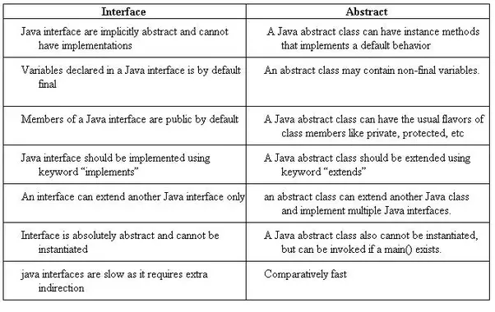
Abstract class vs. Interface

Slide 34
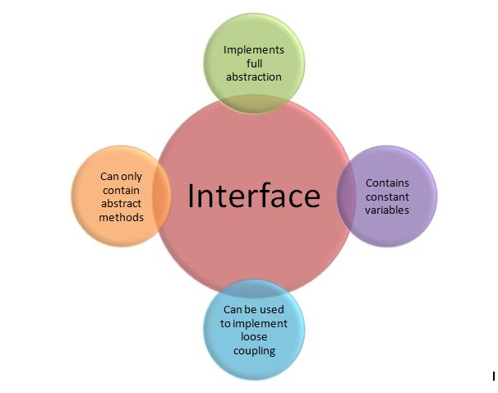
Interface
interface
interface
class
class
interface
interface
interface

Slide 35
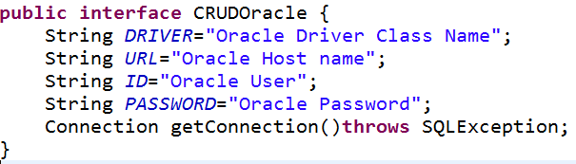
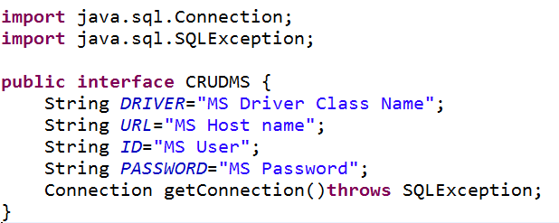
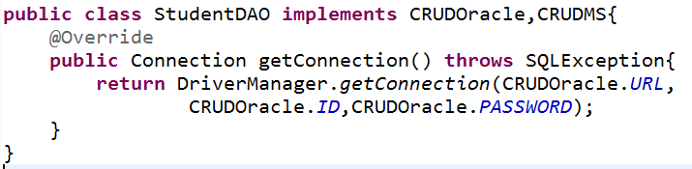
Interface Coding

